Slide 1

Restaurant Review NLP Project
Rymer Popovich, Jake Willingham, Noah Sapper

Slide 2




Project Roadmap
Data / Preprocessing
Performance Evaluation
Defining Problem
Model Implementation
Results Visualizations

Slide 3

Problem Overview
Sentiment Analysis is the identification of tone from textual data
We intend to classify if restaurant reviews are positive and negative
We will use NLP classification to accomplish this

Slide 4
Data and Preprocessing
Preprocessing
Initial preprocessing (null check, data splitting - 70/20/10)
Tokenizing using DistilBERT
Converting text to tokens using a pre trained vocabulary list and separator tokens
Data
Our dataset was found on Kaggle
977 records of restaurant reviews that are either considered positive or negative (1 or 0)

Slide 5

Model Implementation
Sentiment Analysis is the identification of tone from textual data
We intend to classify if restaurant reviews are positive and negative
We will use NLP classification to accomplish this

Slide 6
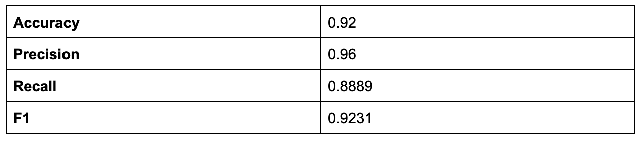
Performance Evaluation
After the model had completed its training, we evaluated the performance metrics (Accuracy, Precision, Recall, F1)

Slide 7
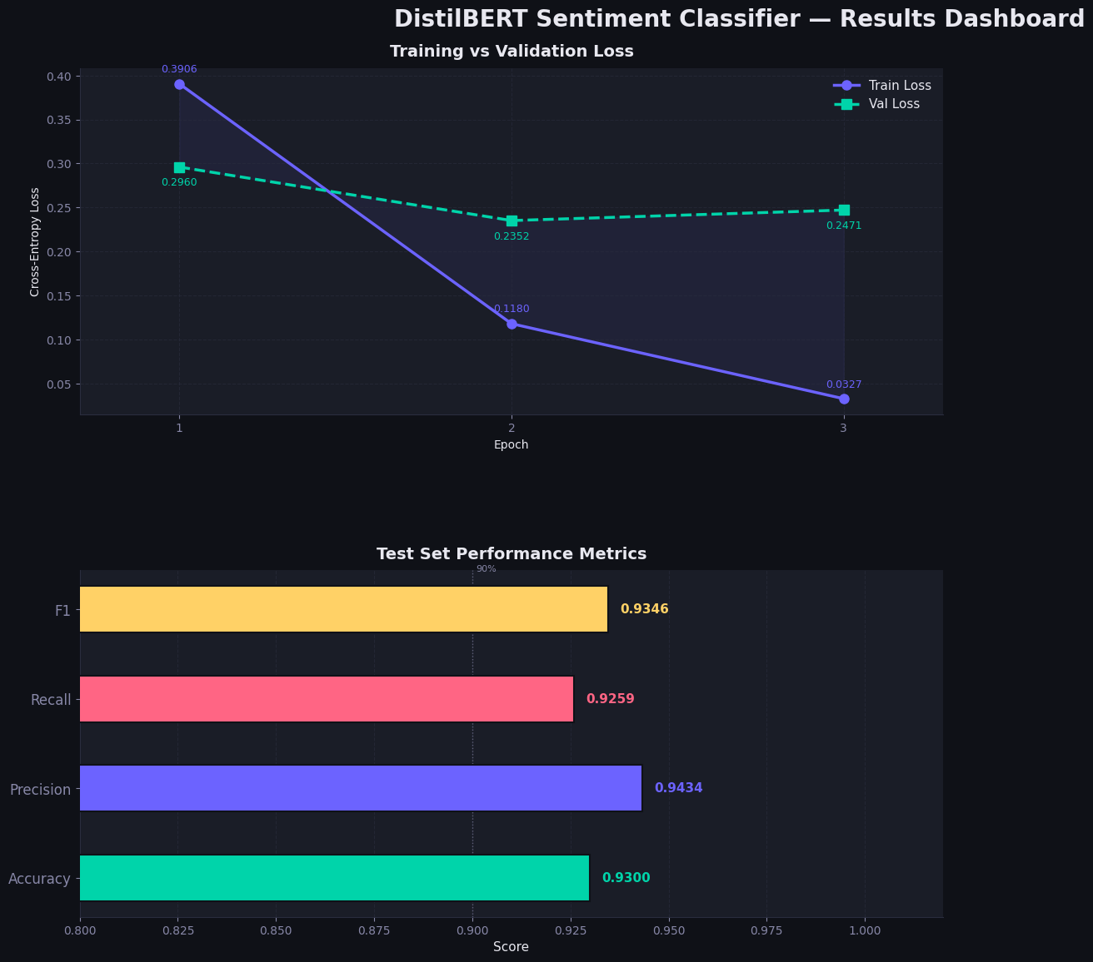
Results and Visualization
Training loss decreased sharply within 3 epochs
Test accuracy reached 93.0% showing strong generalization
DistilBERT fine-tuning achieved high predictive performance with stable validation behavior and strong class balance.

